Slide 1

ClimateWins Predictions
Jordan Novelli
Data Analyst
June 21th, 2025
Notes:
Hi, I’m Jorda Novelli, an up-and-coming data analyst. In this presentation we’ll be analyzing how I used machine learning to explore weather data.

Slide 2

Table of Contents
Objective and Hypothesis
Sources, Bias, Accuracy
Data Optimization
Supervised Learning Algorithms
Summary
Conclusion
Notes:
Hi, I’m Jorda Novelli, an up-and-coming data analyst. In this presentation we’ll be analyzing how I used machine learning to explore weather data.

Slide 3

Objectives and Hypothesis
Objective: Use machine learning to help predict the consequences of climate change.
Hypothesis 1: The climate hasn’t changed much from 1973 until 2022.
Hypothesis 2: There was nicer weather about 50 years ago.
Hypothesis 3: 70% of days in Europe aren’t days with pleasant weather.
Notes:
We’ll slowly explore how the weather has changed from 1960-2022. We’ll gather evidence to explore our hypotheses.

Slide 4
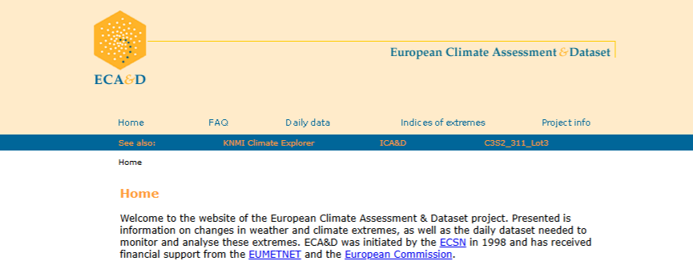
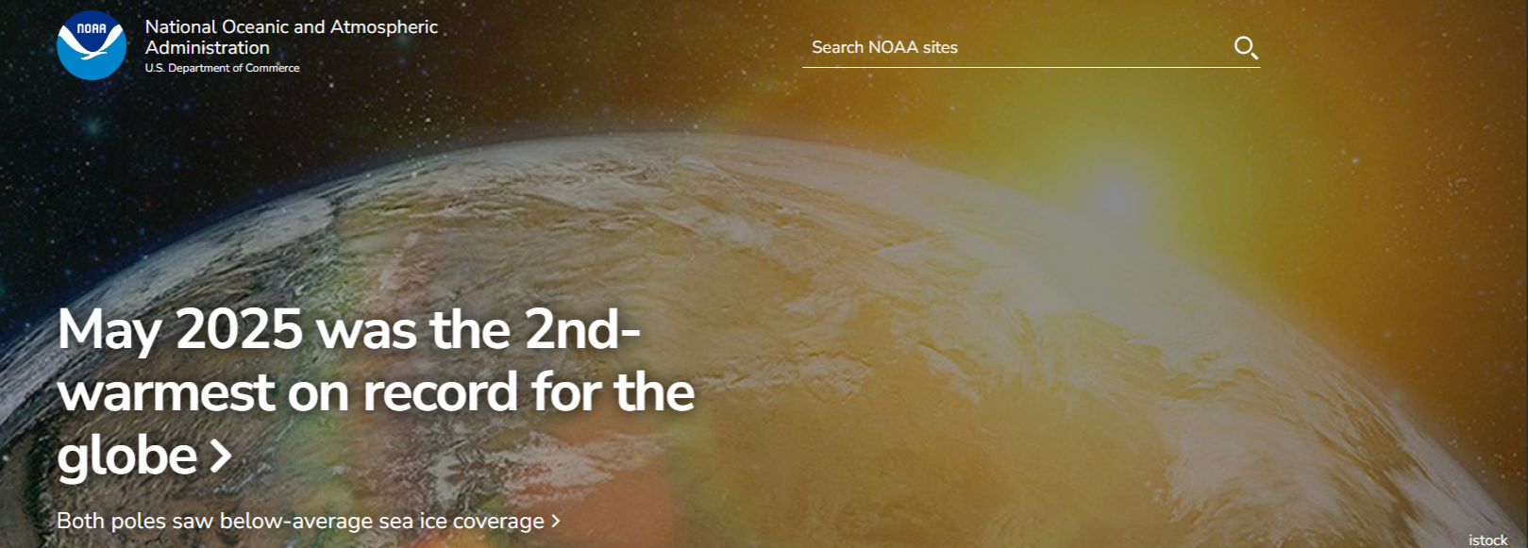
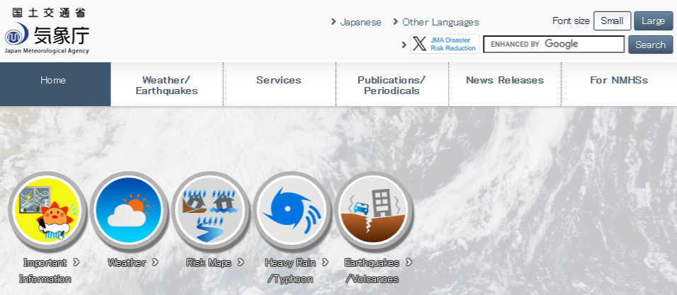
Sources, Biases, Accuracy,
Data Sources:
European Climate Assessment & Data Set project
The National Oceanic and Atmospheric Administration (NOAA)
The Japan Meteorological Agency (JMA)
Bias: ML algorithms or personal bias.
Accuracy: Always a potential for inaccurate results
Notes:
The data we are using comes from the European Climate Assessment & Dataset. This data is comprised of 18 different weather stations across Europe. The data ranges from 1960-2022. That gives us 62 years of weather information to work with.
Our fictional company ClimateWins has been using hurricane predictions from theNational Oceanic and Atmospheric Administraion as well as the Japan Meteorological Agency’s typhoon data. ClimateWins wants to help predict the consequences of climate change.
Biases are always in our thoughts when developing algorithms that help us predict information. Data can be skewed to interpret data negatively. Also personal biases about pleasant weather can come into play. Everyone interprets weather differently. Some people may like hotter weather vs cooler weather, some people may like windy days others may not.
Accuracy can become an issue if we overfit or underfit the data. It’s important to have algorithms that help to level out the predictions.

Slide 5
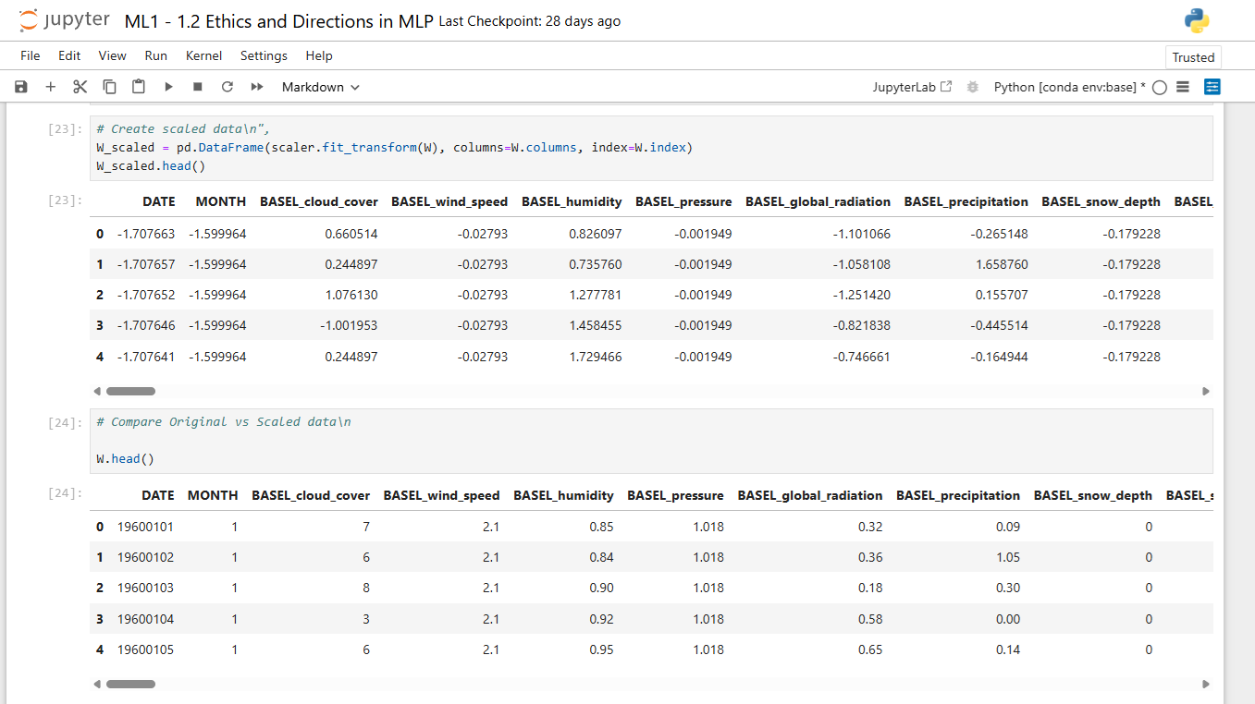
Data Optimization
Gradient Descent was used to optimize the data.
Scaled
Box and Whisker Plot
Scatterplot
Loss Function with 3D Models
Notes:
Gradient Descent was used to find local minimums in our data.
Before using GD, we scaled the data to make it easier to find difference between the weather stations. You don’t see actual temperatures, but it helps to make the data easier to use with our machine learning algorithms.

Slide 6
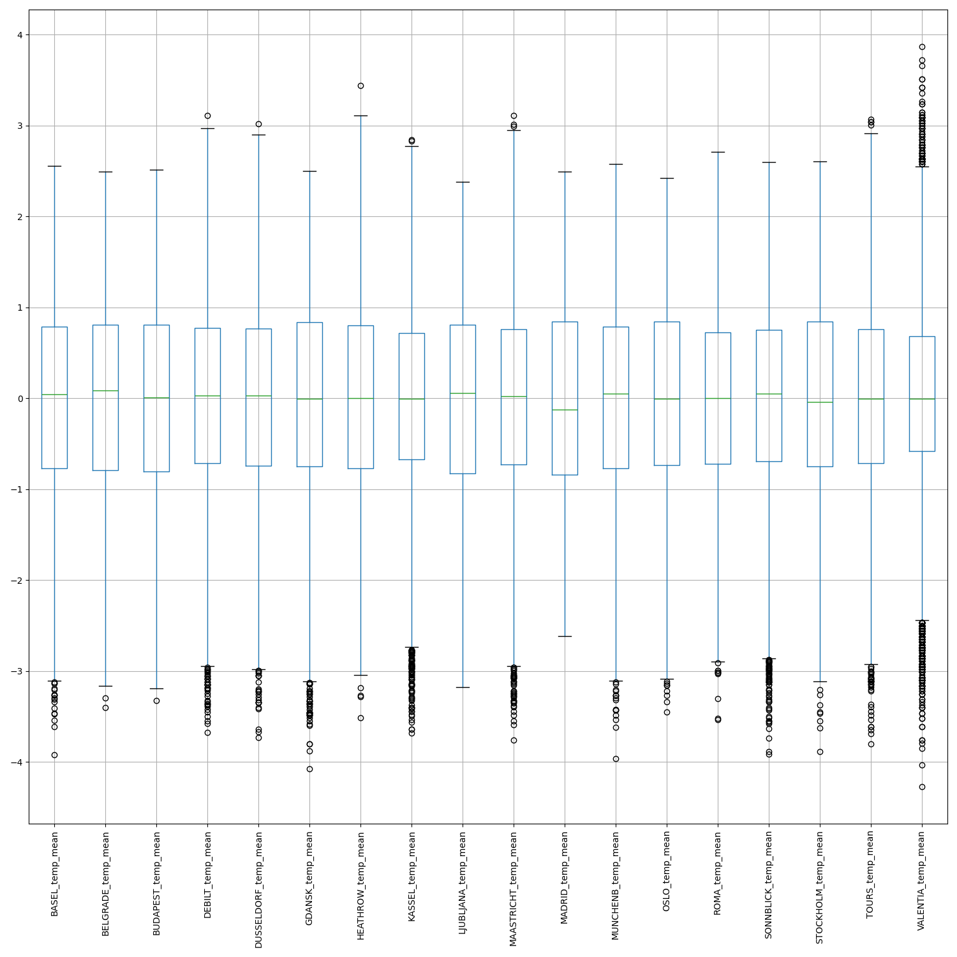
Data Optimization
Gradient Descent was used to optimize the data.
Scaled
Box and Whisker Plot
Scatterplot
Loss Function with 3D Models
Notes:
A box and whisker plot was created to find difference in the mean temperature of each weather station. Just studying this box plot we can see many weather stations have temperatures outside the range of the box plots and other are fully encompassed inside the box plot. These weather stations that have data outside the box plot may lead to more inaccurate predictions. Our lower temperatures are represented by the negative variables on the y-axis. As the temperatures increase, they move into the positive variable on the y-axis.

Slide 7
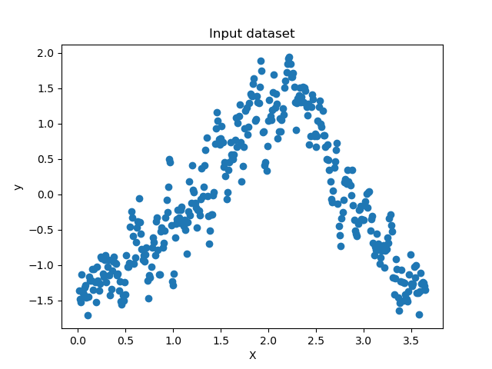
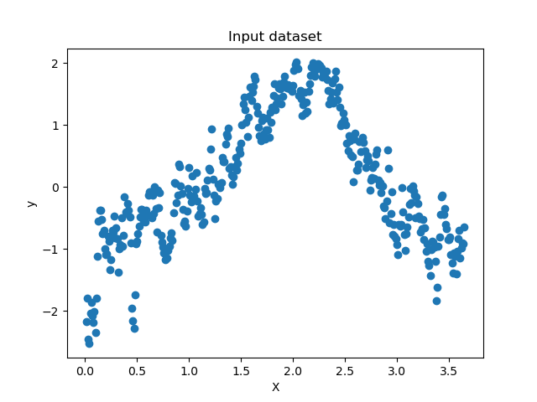
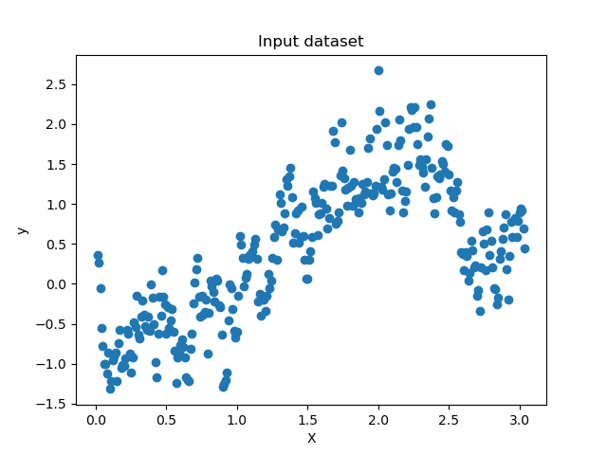
Data Optimization
Gradient Descent was used to optimize the data.
Scaled
Box and Whisker Plot
Scatterplot
Loss Function with 3D Models
Madrid year 1973
Oslo year 1997
Debilt year 2022
Notes:
Scatterplots were created for the 3 weather stations we explored. Those weather stations were Madrid in year 1793, Oslo in year 1997 and Debilt in 2022. Each point on the plot represents a temperature collected by the specific weather station. The y-axis is the scaled temperature points. The x-axis represents the days of the year as an index format from day 1 through day 365. In Debuilt’s case there are only 304 days of data collected.

Slide 8
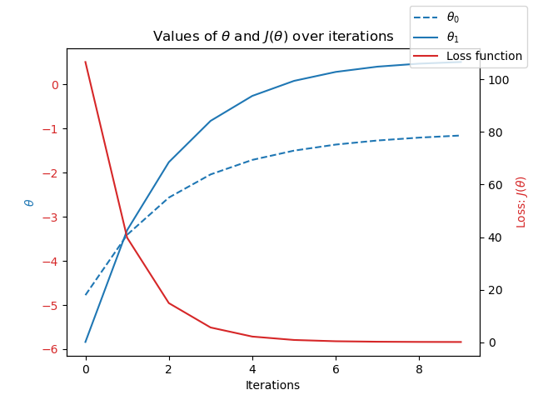
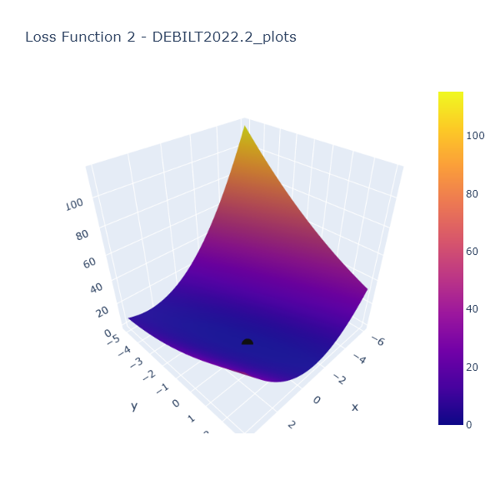
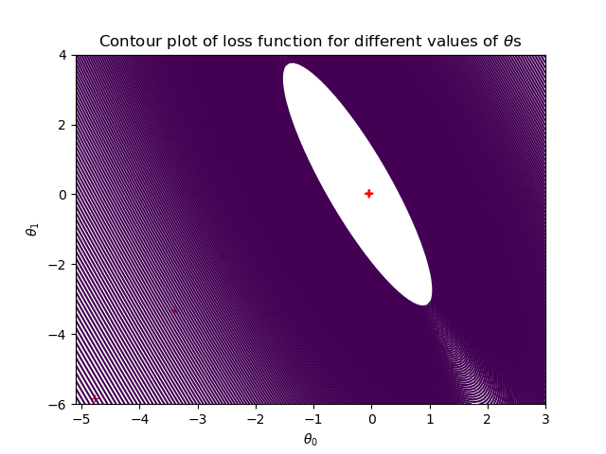
Data Optimization
Gradient Descent was used to optimize the data.
Scaled
Box and Whisker Plot
Scatterplot
Loss Function with 3D Models
Notes:
The Loss Function helps you see how the data is moving and where it is converging. We use the data from the Loss Function to see where the theta0 and theta1 begin and max out at. We take the plots on the graph to help create a 3D model. We then use the 3D model to explore where the data converges at zero. In this image we’re looking at Debilt’s Loss Function graph and then the 3D model. It ran three 3D model algorithms in order to find the convergent point. The purple image here show the interpreted contour plot where it’s a 2D visualization.

Slide 9
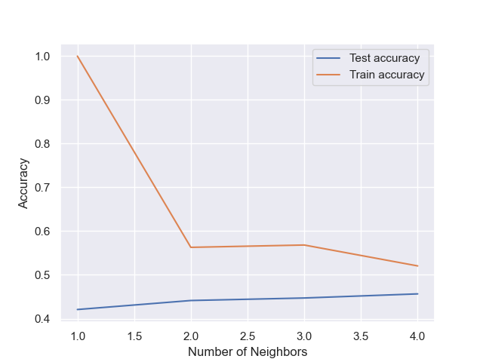
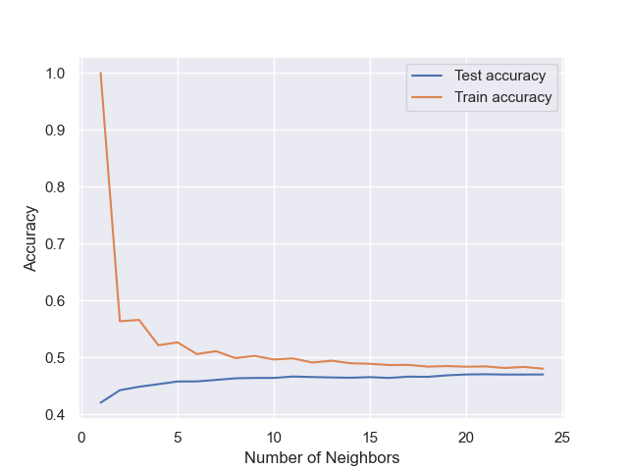
Supervised Learning Algorithms Best Fit
K-Nearest Neighbor
Decision Tree
Artificial Neural Network
Notes:
K-Nearest Neighbor (KNN)
In KNN, we adjust the number of neighbors that the algorithm uses to compare each data point to. This algorithm will decide how to group our data based on the number of neighbors. By slowly adjusting the neighbor size our algorithm can more confidently group the data. To many neighbors can cause overfitting and too little neighbors can cause underfitting. We plot a relationship between the testing and training accuracy and use this to understand how many neighbors are too little or too many and also see the accuracy.
We use confusion matrices to further compare what KNN got right and what it got wrong and depending on the split we used to train and test our data we can determine the percentage of each.
You can see in the first Relationship graph where 5KNN was used the training accuracy starts at 100% and drops to 57% after two neighbors. The Test accuracy starts at about 42% and slowly increases to 47%.
The second graph using 25KNN, the comparison begins to degrade significantly going as low as 48% and the testing accuracy begins to meet it at about 46%

Slide 10
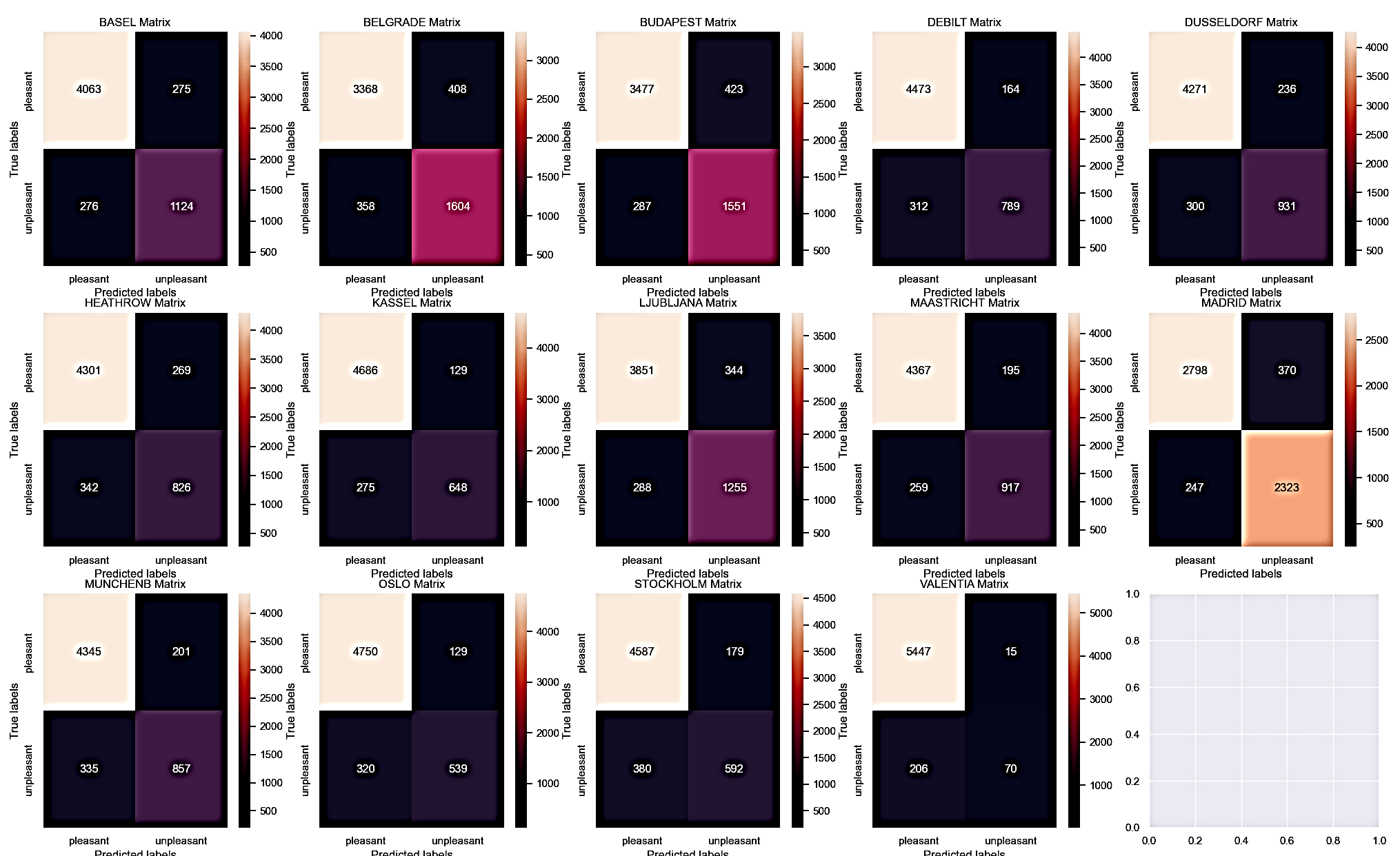
Supervised Learning Algorithms Best Fit
K-Nearest Neighbor
Decision Tree
Artificial Neural Network
Notes:
The confusion matrices used the testing data. This confusion matrix displayed was the result of the 25KNN. In comparison to the 4 total KNN algorithms run the 25KNN was the most accurate. There was an avg of 72% pleasant weather, 16% unpleasant weather and 8% of the data that wasn’t grouped. Of these 18 total weather stations only 14 were utilized. Of the 14 the top 5 with the more pleasant weather were Valentia, Oslo, Kassel, Stockholm and Debilt.

Slide 11
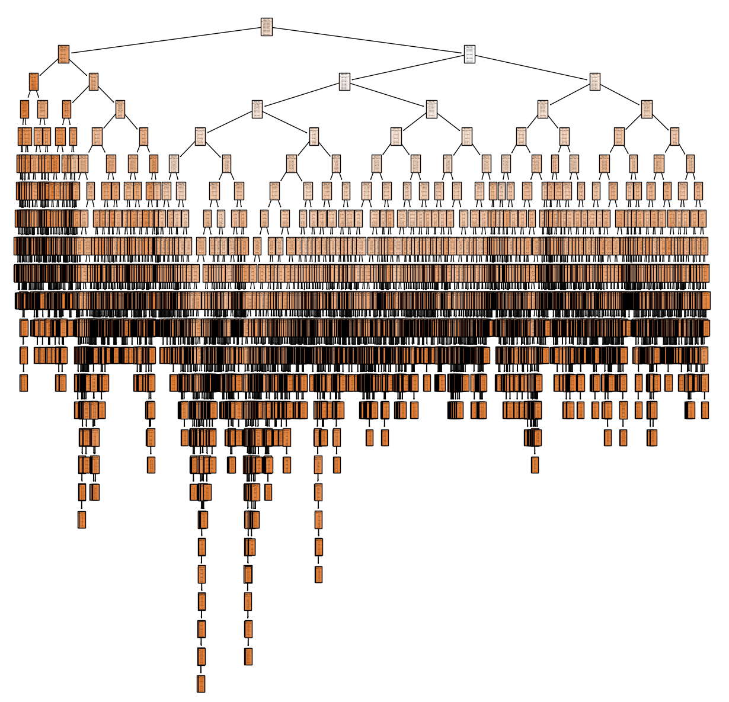
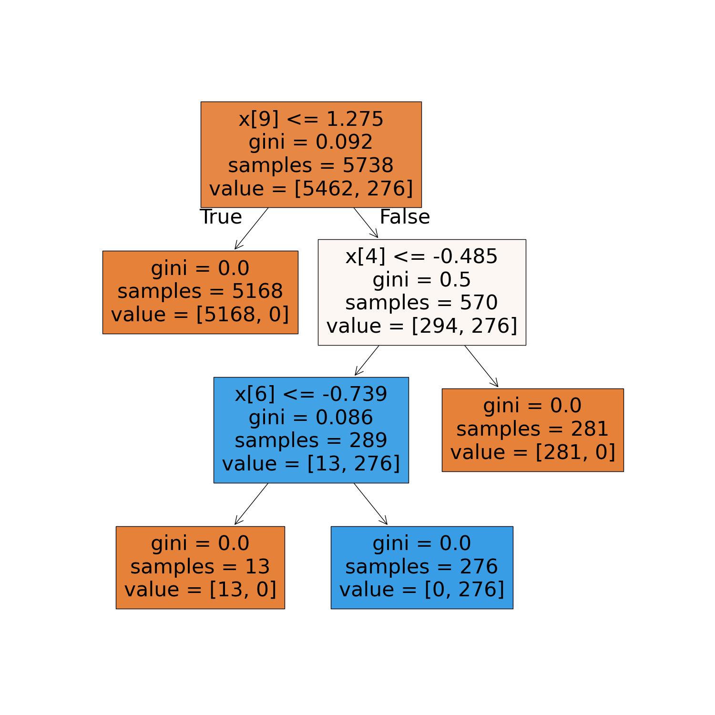
Supervised Learning Algorithms Best Fit
K-Nearest Neighbor
Decision Tree
Artificial Neural Network
Notes:
The decision trees work great with nonlinear data because it can find patterns. However, it can easily overfit the data if the number of branches is too high. With the data being so large it’s hard to read the decision tree. I began pruning the tree with the large dataset and it didn’t change the aspect ratio of the tree. I further pruned the tree using only the pleasant weather data of specific weather stations I was looking at. I chose to look at the top 5 weather stations with the most pleasant weather. The smaller decision tree comes from Valentia. You can see with such a small dataset it’s able to make quicker decisions but this could lead to overfitting.

Slide 12
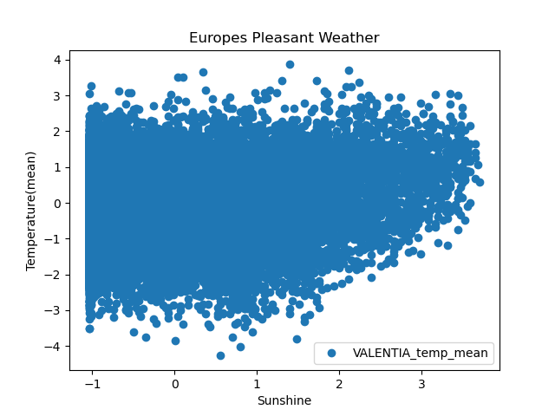
Supervised Learning Algorithms Best Fit
K-Nearest Neighbor
Decision Tree
Artificial Neural Network
Notes:
In the grand scheme of things, we could conduct a regression algorithm to try and fit the data along a line. However attempting this step by looking at a scatterplot prepped for regression showed numerous data points that would be difficult to transform along a linear regression function.

Slide 13
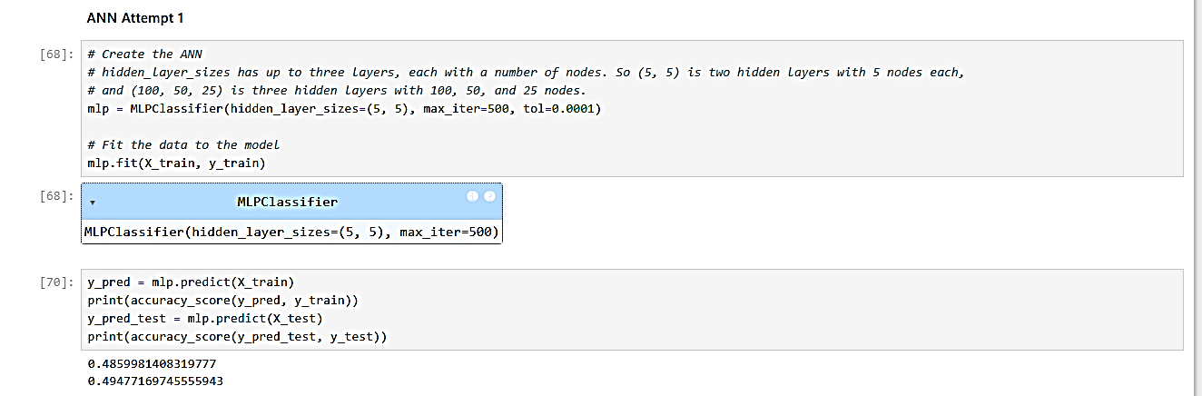
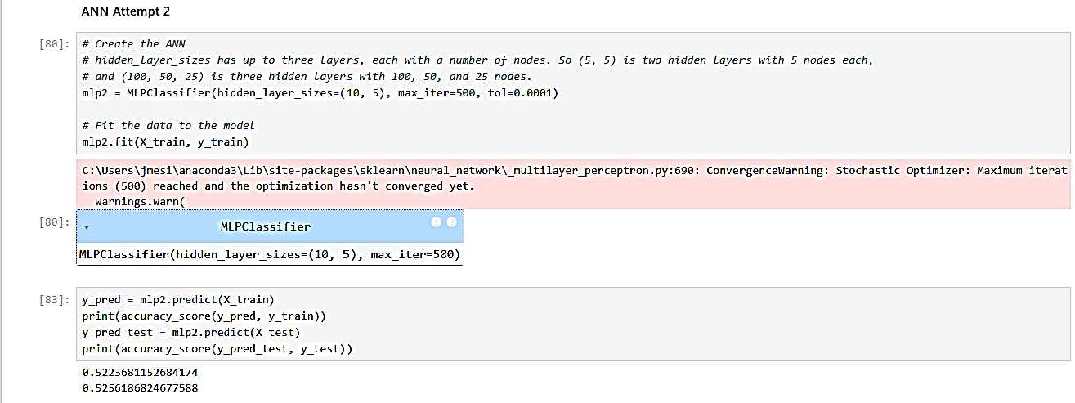
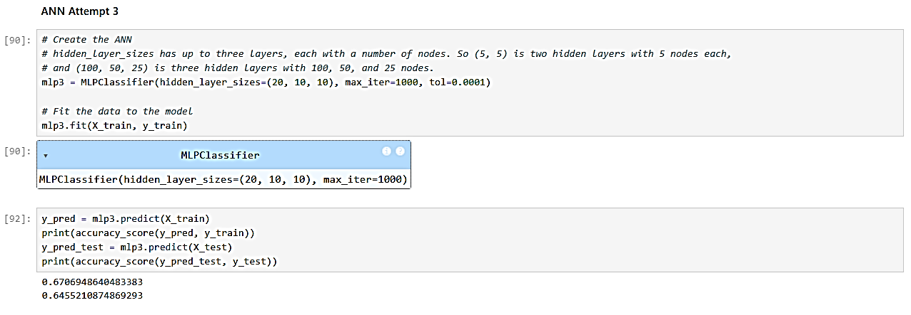
Supervised Learning Algorithms Best Fit
K-Nearest Neighbor
Decision Tree
Artificial Neural Network
Notes:
Artificial Neural Networks are supervised machine learning models that act like unsupervised models. When exploring our training and testing we had the opportunity to adjust hidden layer size, iterations and the expected loss of the model to have more successful accuracy.
Our first ANN started out with a training accuracy of 48% and a testing accuracy of 49.4%. That’s not the best as they’re under 50%.
Our second ANN we had kept the two hidden layers but adjusted their number. The training and testing accuracy was 52%, that’s a 3-4% increase!
The final ANN we ran was composed to three hidden layers with alter numbers, an increased iteration and we left the expected loss the same. Our training model cam out with 67% accuracy and our testing was 64%. The training accuracy improved by 18% from the original ANN and the testing improved by 14%.

Slide 14
Summary
Hypothesis 1: The climate hasn’t changed much from 1973 until 2022.
The climate has begun to increase in temperature according to these scatterplots.
Madrid year 1973
Debilt year 2022
Notes:
Hypothesis 1: The climate hasn’t changed much from 1973 until 2022.
According to the two scatter plots the climate has begun to see increases in temperature. If the y-axis acts as the temperature and x-axis act as the days in the declared year, there is a slight increase. I can’t give you the exact temperature but looking at Madrid in 1973 the temperature didn’t go passed 2.0 and there were more clusters of cool to warm temperature. In Debilt year 2022 the cooler temperature are more sparse and the warmer temperatures go well passed 2.0 into the 2.5 and above.

Slide 15
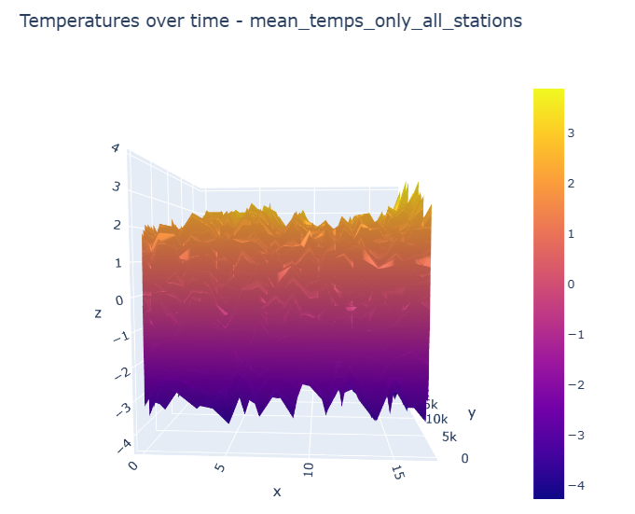
Summary
Hypothesis 2: There was nicer weather about 50 years ago.
There is some temperature increase from years 1960-2022
Notes:
Hypothesis 2: There was nicer weather about 50 years ago.
Using this 2D surface plot contained the mean temperatures of 14 weather stations and years from 1960-2022 we can interpret some nicer weather about 50 years ago. From left to right, temperature stays around 2.5-3 and about half way the temperatures begin jumping into the 3-3.5 mark. This could easily indicate that temperatures are warming up.

Slide 16
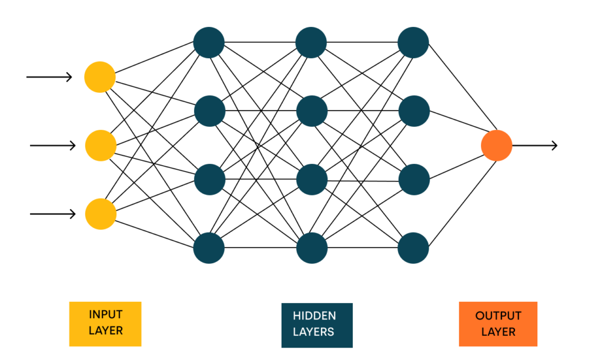
Summary
Hypothesis 3: 70% of days in Europe aren’t days with pleasant weather.
Majority of the time the average pleasant weather was 72%
My chosen Machine Learning Algorithm is Artificial Neural Networks.
Next steps would be to run a regression model on the larger dataset. Deeper dive into the data.
Notes:
Hypothesis 3: 70% of days in Europe aren’t days with pleasant weather.
Through all the training and testing confusion matrices I conducted I calculated the pleasant, unpleasant and uncategorized data. The average pleasant weather between the 12 training and testing confusion matrices was 72%.
CHOSEN ALGORITHM:
ANN – I like the ability to control various parts of the model to determine success or failure. I like that I get to view where my training and testing accuracy lie before plotting a training and testing confusion matrix to visually interpret how everything is running.
NEXT STEPS:
Take a deeper dive into the Regression of the decision tree. The DT were very large and because of that they were harder to read. When making smaller subsets of the data to visualize a DT they were easier to read but most likely promoting overfitting. It’s not very practical to use a decision tree with such a large amount of data nor is it practical to divide the data up piece by piece just to create a legible DT. I’d also like to take a deeper dive with the weather and see if we can really predict hurricanes or find the best weather by month of the year in Europe. It would be interesting to put the data ClimateWins is explore from the National Oceanic and Atmospheric Administration and the Japan Meteorological Agency to the test.

Slide 17
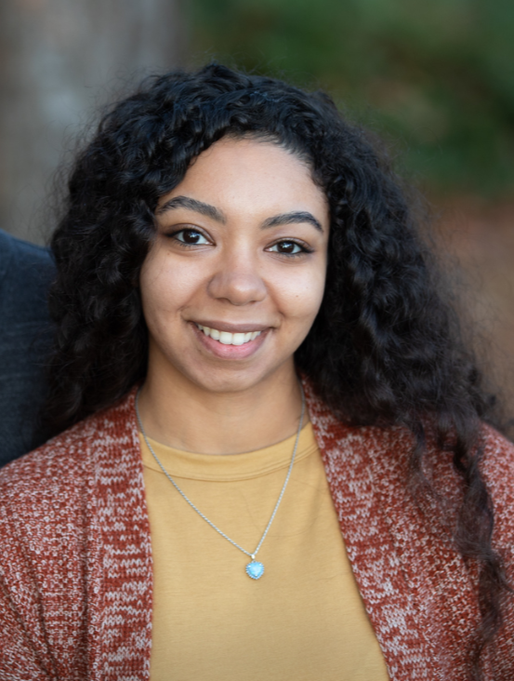



Thank You!
Thank you for joining me on this machine learning journey.
I’m happy to take questions from the audience.
Check out my work for this project on Github.
Check out my LinkedIn
Explore my website outlining my projects.
Jordan Novelli

